Slide 1

Project Management System
Matome Isaiah Ramafalo, 201583776, CSC3A Mini Project

Slide 2
Table Of Content
What is Project Management System.
Identified Problems.
Solutions for the problems.
Methodology used.
Rrequirements.
The Process Of the System.
How the System Works.

Slide 3
What Is Project Management System?
Project Management System is a software program that is designed to solve the UN sustainability goal 9(Industry, Innovation an Infrastructure) using Graphs ADT in java.
It can be used in large projects to layout what components rely on other components, what tasks rely on other tasks and to minimize the total time or cost to completion while abiding by the dependences.

Slide 4
Identified Problems
Project delays:
This occurs when projects managers don’t know which project components to purchase first and which tasks to prioritise.
Cost overrun:
Unexpected costs incurred in excess of budgeted amounts due to an underestimation of the actual tasks and components cost during budgeting.
Available funds:
Projects funding received on periodic basis which makes it difficult to go according to project plan and prolongs the project completion time.
NB: These problems lead to poor Industry, Innovation and infrastructure development.

Slide 5
Solutions for the problems
Project delays:
The program creates a clear components and tasks layout and their dependencies and it also provides tasks critical path calculation functionality.
Cost overrun:
The program provides tasks costs and duration calculation functionalities which will allow project managers to see how much they have to spend for each task and this functionality minimizes project cost.
Available funds:
Given the available funds and preferred starting task, the program provides tasks prioritisation functionality. This functionality makes sure that project progress is not interrupted by available cash.

Slide 6
Methodology used
Graph vertices are used to store tasks and components information.
Graph edges are used to store dependencies between components and tasks as well.
Graph Depth-First Search(DFS) and Breath-First search(BFS) functionalities are used to determine all possible path between tasks and components as well.
Dijkstra’s algorithm is used to determine the best tasks critical path cost and duration given available cash and preferred start task.

Slide 7
Requirements
The program should be robust.
The program should clearly draw the components and tasks graphs.
The program should calculate critical path between any two tasks.
The program should optimize projects given correct information.
The program should be able to create new and open existing projects.
The program should output status messages if any error occurs or if changes are made.

Slide 8
The Process Is Easy
Add components
Add Tasks
Manage Cost
Manage Time
Optimize Project

Slide 9
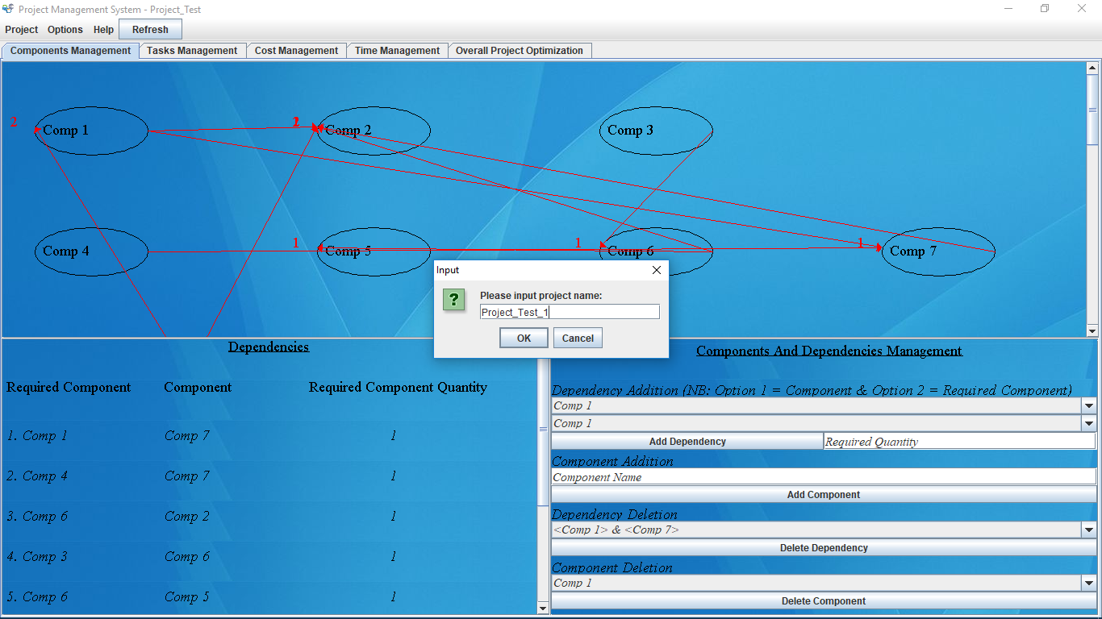
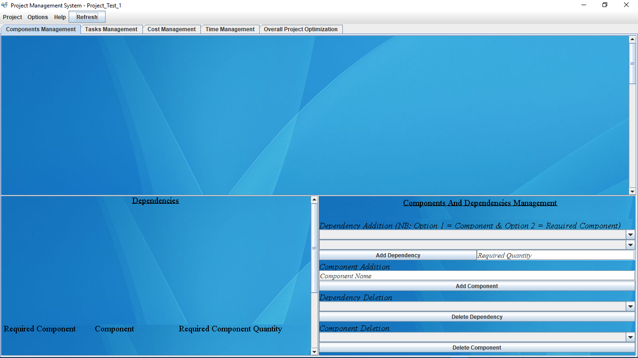
How The System Works - New Project creation
Click Project – New Project - to create a new project.
New Empty Project.

Slide 10
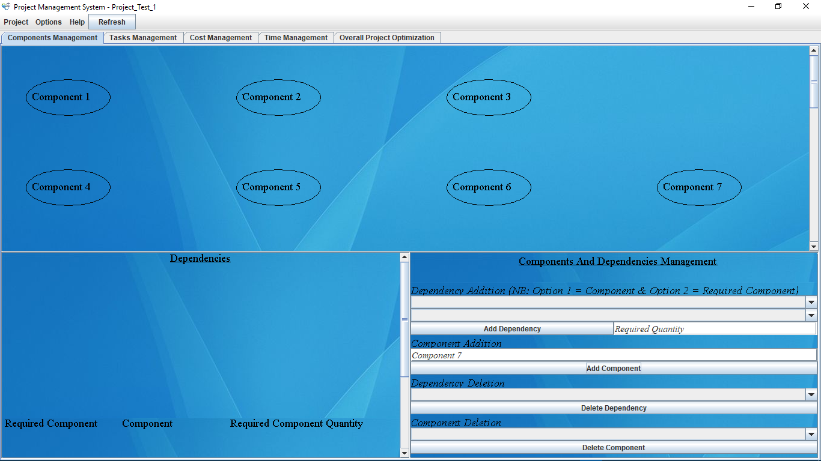

How The System Works - Continued - Project Components Addition
Fill in‘ Component Name’ textbox and click ‘add component’ button to Add new components.
Click refresh to load all tasks to workspace.

Slide 11
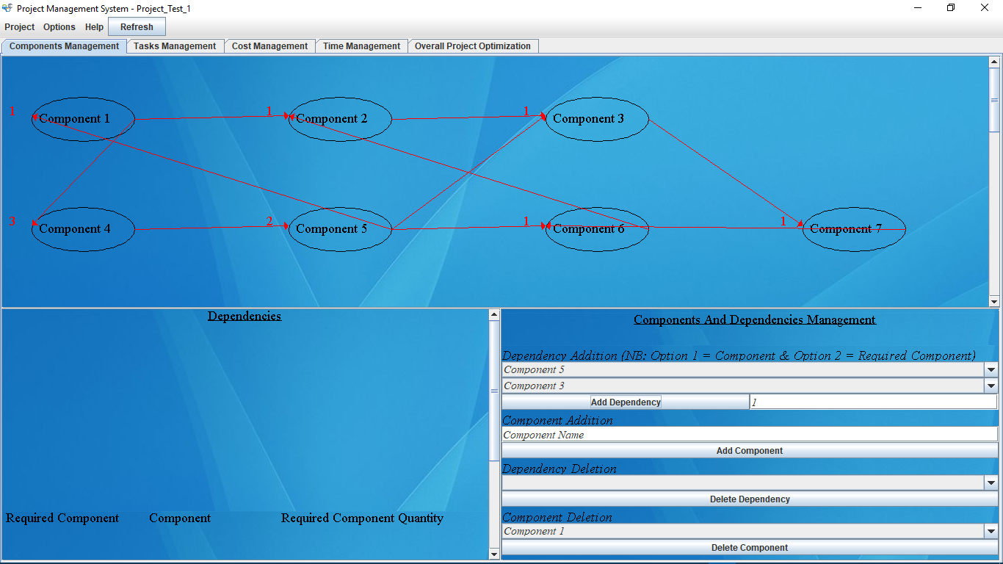
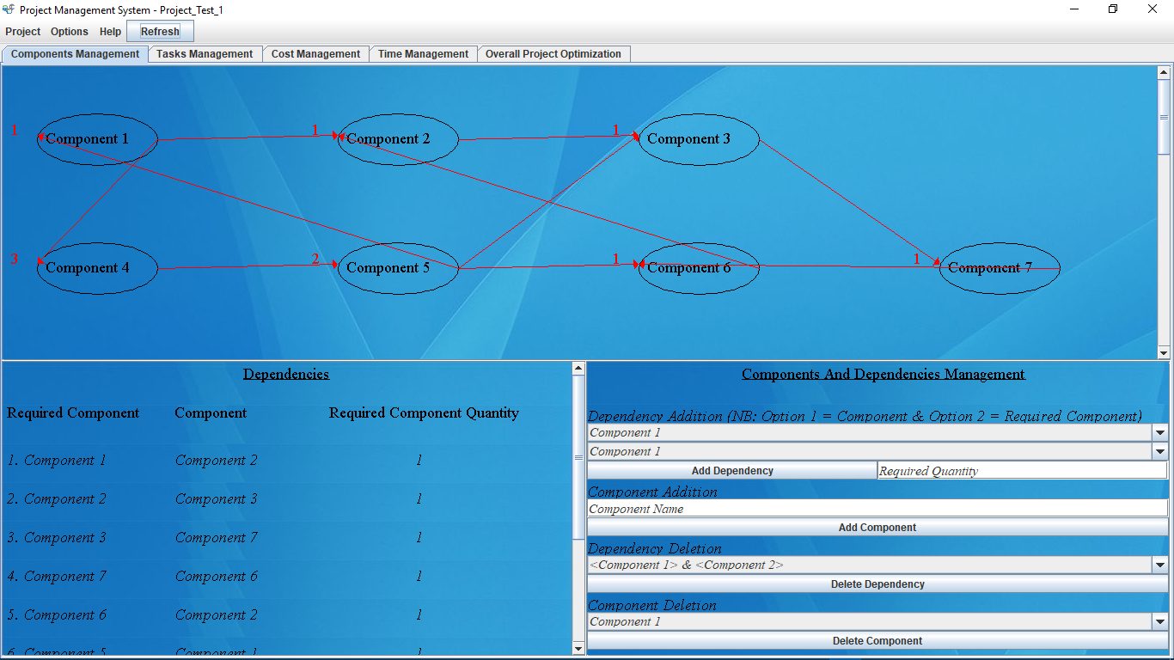
How The System Works - Continued - Project Components Dependencies Addition
Select Two components and Click ‘Add Dependency’ button to create a new dependency between components
Click refresh button to load dependencies to workspace

Slide 12
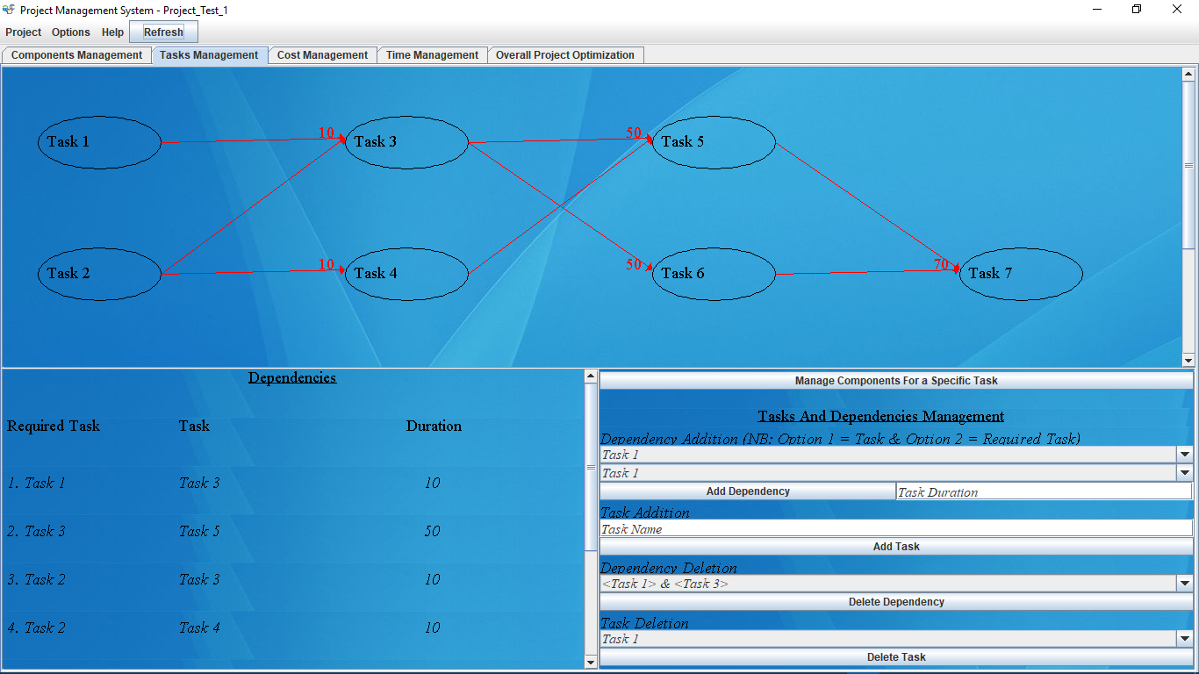
How The System Works - Continued - Project Tasks and Dependencies Addition
The process is the same as for adding components and dependencies.

Slide 13
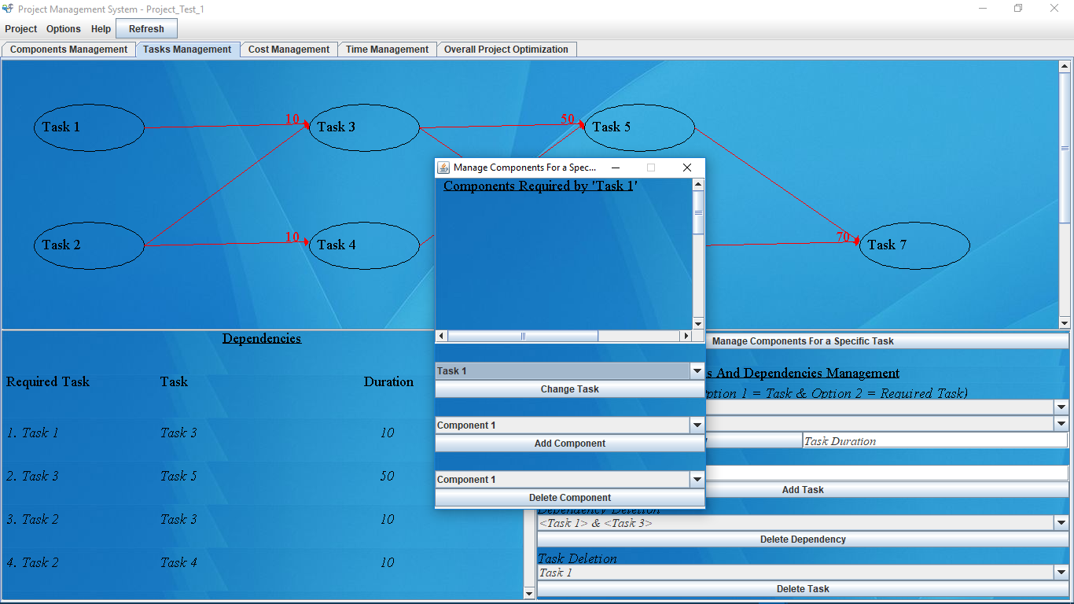

How The System Works - Continued - Tasks components settings
Click ‘Manage Components for a specific Task’ to set components required by a specific task and below that select component and click ‘Add Component’.
Select Task and Click ‘Change task’ to move to the next task.

Slide 14
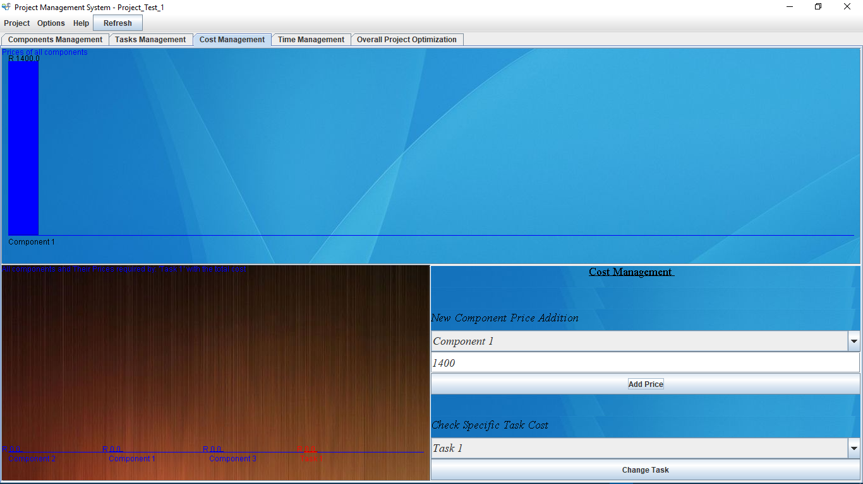
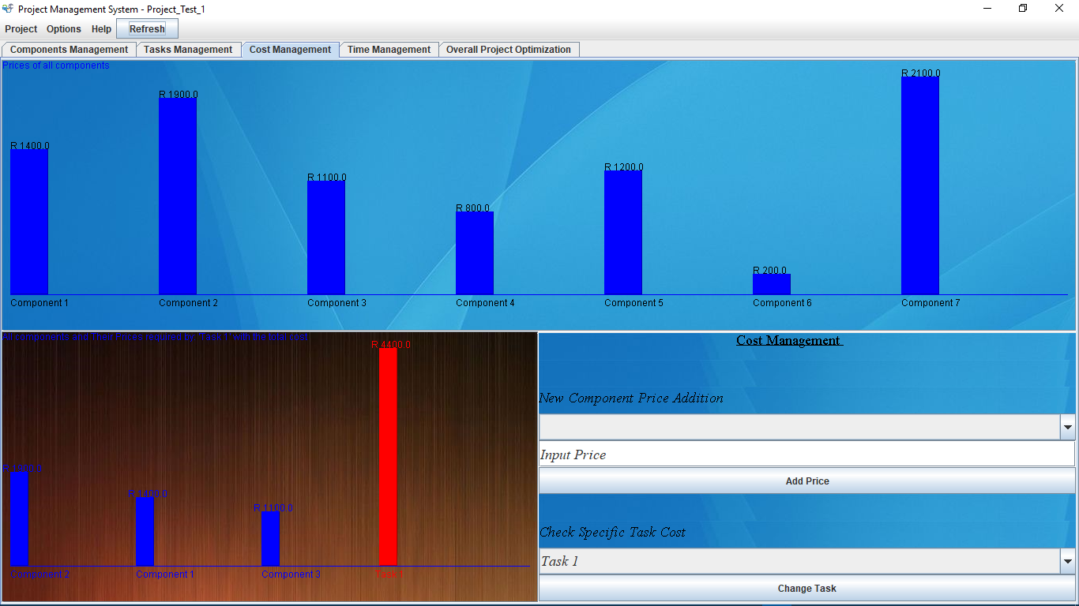
How The System Works - Continued - Cost Management
Select Component, type In the price(a number) and click ‘Add price’ to add a price for a specific component.
Click refresh button after adding a new price and select task and click ‘Change Task’ to view cost of the selected task.

Slide 15
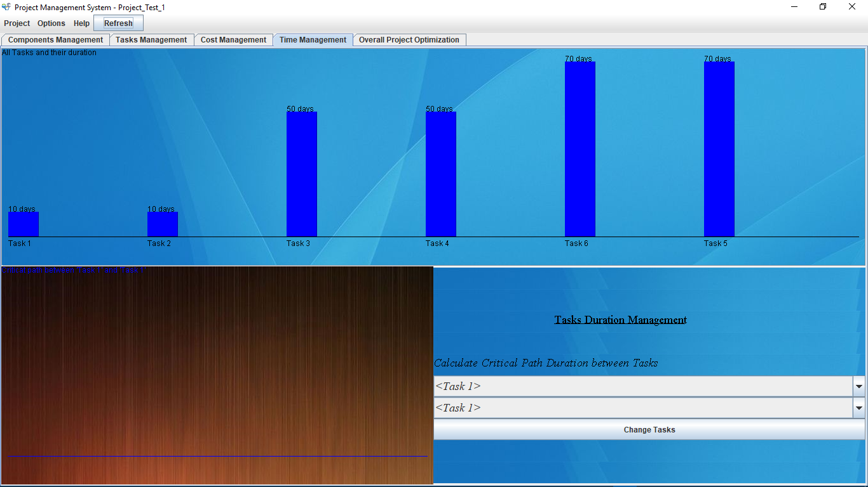
How The System Works - Continued - Time Management
Select Tasks and click ‘Change Tasks’ to determine the critical path between the two Tasks.

Slide 16
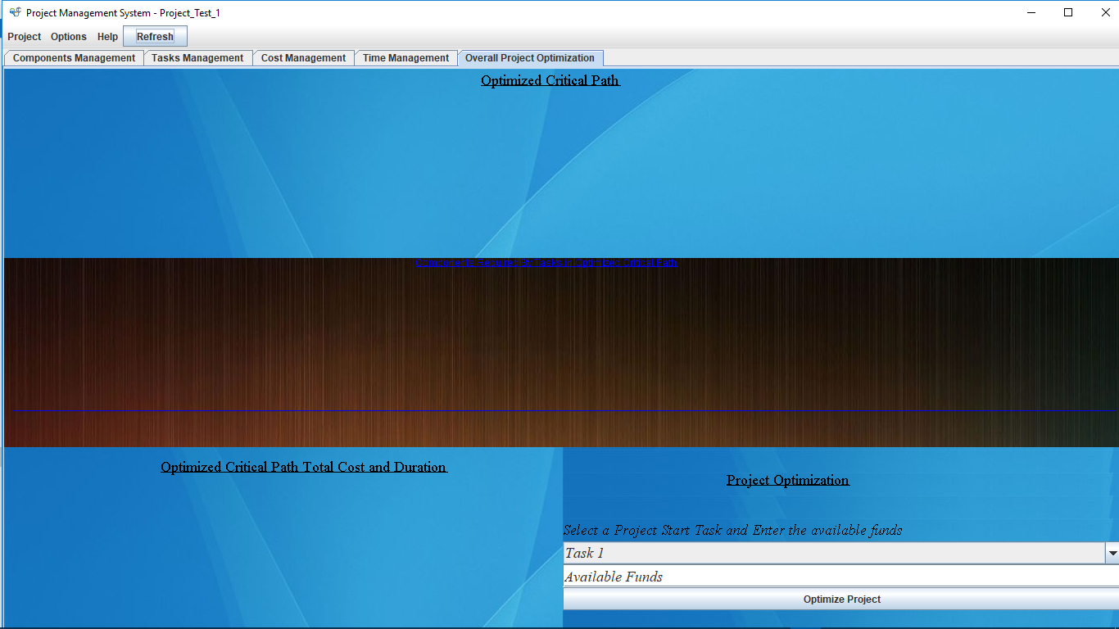
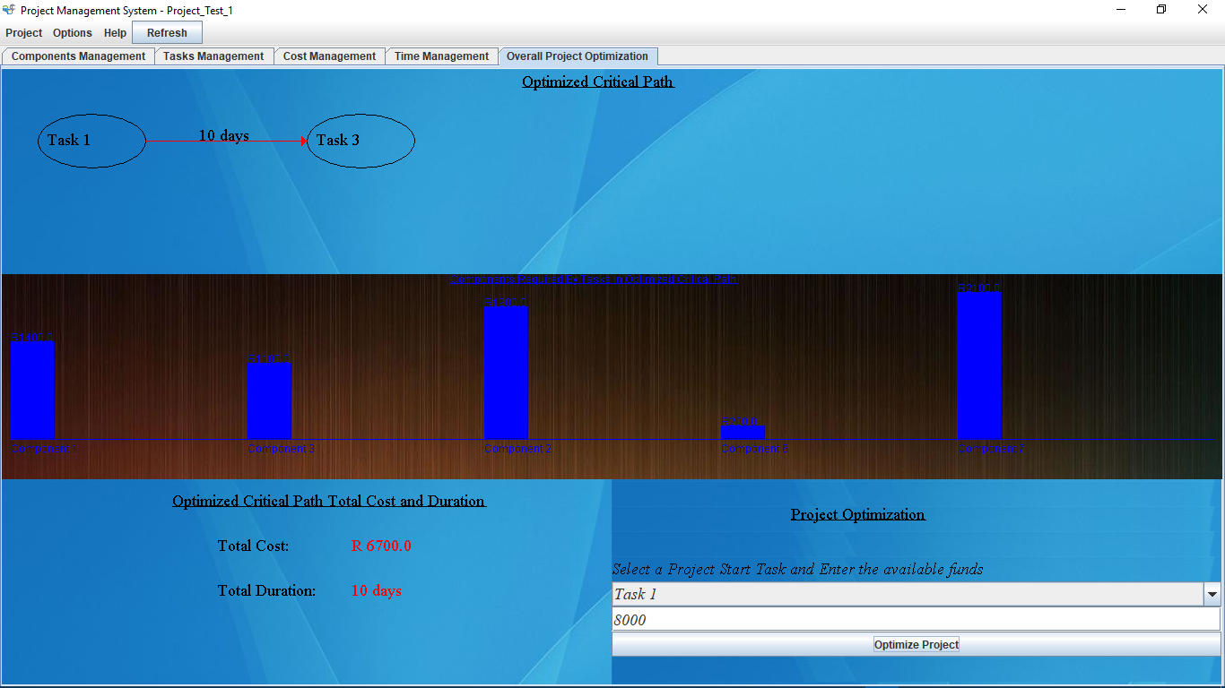
How The System Works - Continued - Overall Project Optimization
Unoptimized project.
Select a preferred project starting task, type in the project available funds and click ‘Optimize Project’

Slide 17
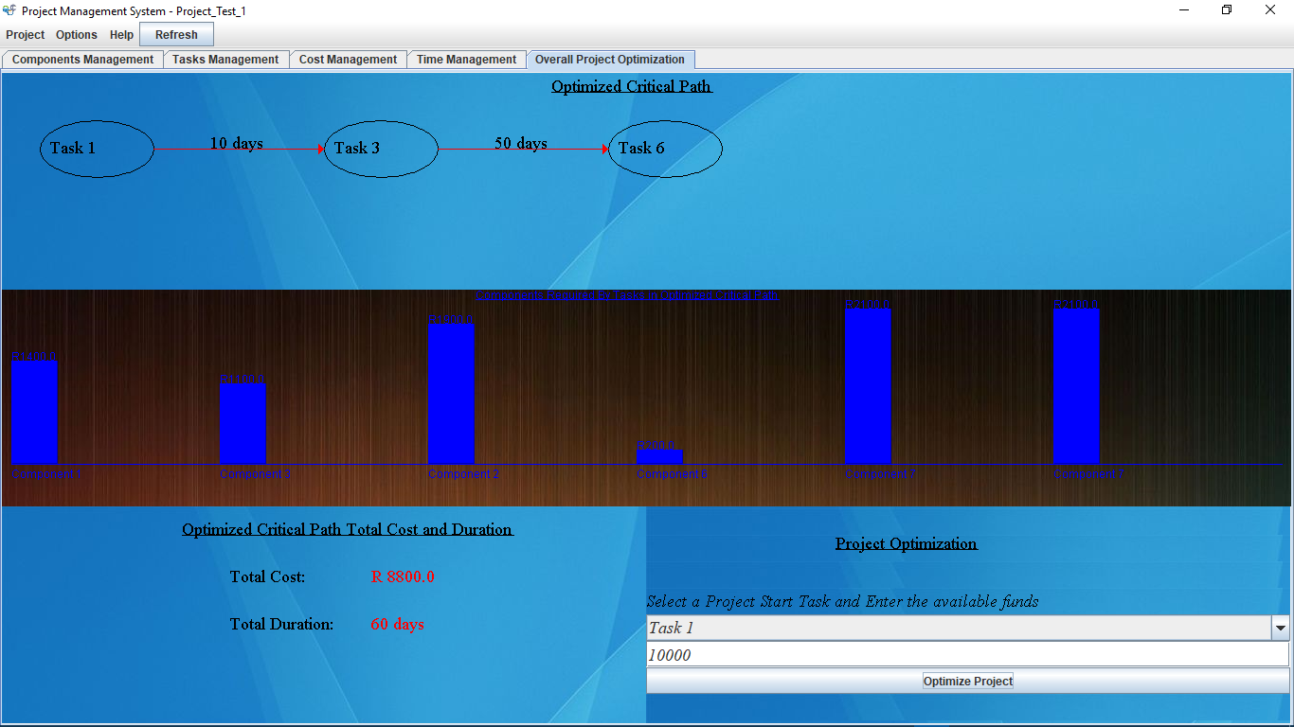
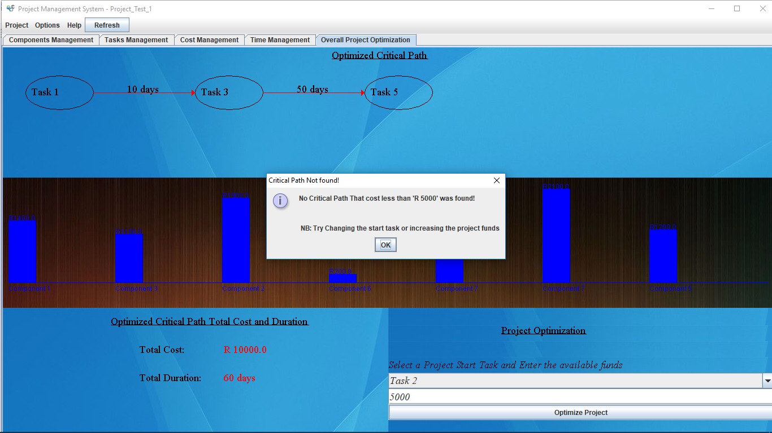
How The System Works - Continued - Overall Project Optimization - continued
Keep on changing starting tasks and available funds to obtain best results.
Keep on changing starting tasks and available funds to obtain best results.

Slide 18
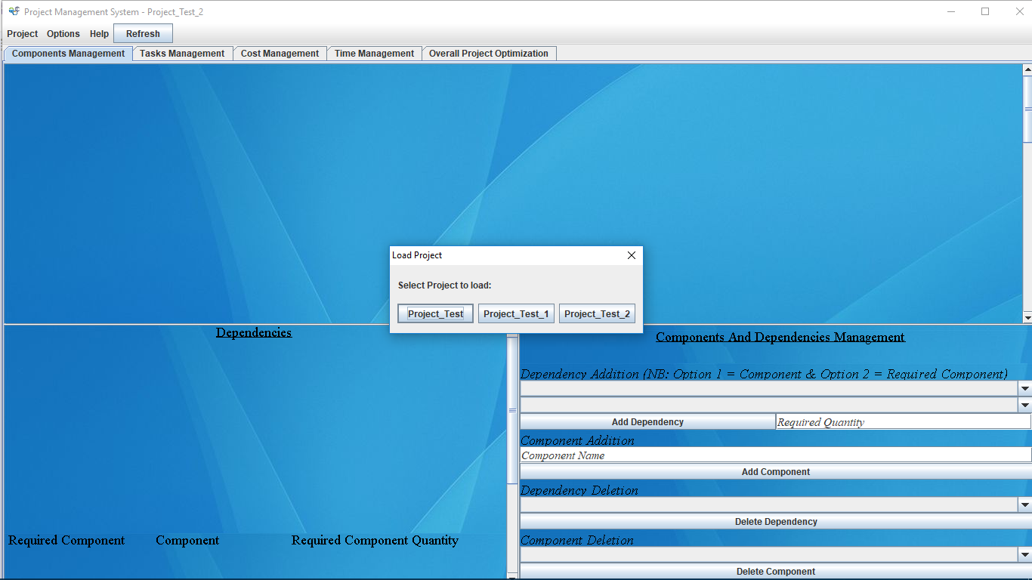
How The System Works - Continued - Loading existing projects
Click Project – Open existing project from file system: - to load previously saved projects

Slide 19
THANKS!

